Slide 1
MOVIE REVIEW AND RATINGS
CAPSTONE PROJECT
Presented By:
HEMANTH RAJ B
KARPAGA VINAYAGA COLLEGE OF
ENGINEERING AND TECHNOLOGY

Slide 2
OUTLINE
Problem Statement
Proposed System/Solution
System Development Approach
Algorithm & Deployment
Result
Conclusion
Future Scope
References

Slide 3
Problem Statement
The task is to develop a sentiment classification model capable of predicting whether movie reviews are positive or negative. The dataset consists of 50,000 movie reviews, split evenly between training and testing sets. Each review is labeled as either positive or negative.

Slide 4
Proposed Solution
To solve this problem, we can follow these steps:
Data Preprocessing:
Load the dataset.
Preprocess the text data by removing stopwords, punctuation, and converting text to lowercase.
Tokenize the text and convert it into numerical representations, such as word embeddings or TF-IDF vectors.
Model Selection:
Choose a suitable classification algorithm or deep learning architecture for sentiment analysis.

Slide 5
System Approach
Model Selection:
Choose a suitable classification algorithm or deep learning architecture for sentiment analysis. Options include:
Logistic Regression
Support Vector Machines (SVM)
Random Forest
Convolutional Neural Networks (CNN)
Recurrent Neural Networks (RNN), like Long Short-Term Memory (LSTM) or Gated Recurrent Unit (GRU)
Transformer-based models like BERT, GPT, etc.
Experiment with different models to find the one that performs best on the dataset.
Model Training:
Split the training set further into training and validation sets to monitor the model's performance during training.
Train the selected model on the training set.
Fine-tune hyperparameters if necessary to improve performance.
Model Evaluation:
Evaluate the trained model on the test set to assess its performance.
Calculate metrics such as accuracy, precision, recall, and F1-score to measure the model's effectiveness.
Analyze any misclassifications and consider refining the model further if necessary.
Deployment:
Once satisfied with the model's performance, deploy it for real-world use, such as sentiment analysis of movie reviews.
Develop a user-friendly interface if needed for easy interaction with the model.
Monitoring and Maintenance:
Continuously monitor the model's performance in the production environment.
Update the model periodically with new data to ensure it remains accurate and relevant.
By following these steps, we can create an effective sentiment classification model for predicting the sentiment of movie reviews, helping users make informed decisions about which movies to watch based on their reviews.

Slide 6
Algorithm & Deployment
Here's a high-level algorithm for sentiment classification of movie reviews using machine learning or deep learning techniques:
1. **Data Preprocessing:**
- Load the movie review dataset containing 50,000 reviews (25,000 for training and 25,000 for testing).
- Preprocess the text data:
- Convert text to lowercase.
- Remove punctuation marks.
- Remove stopwords (common words like "the", "is", etc.).
- Tokenize the text (split into individual words or tokens).
- Convert tokens into numerical representations (e.g., word embeddings or TF-IDF vectors).
- Split the dataset into training and testing sets.
2. **Model Selection:**
- Choose a classification algorithm or deep learning architecture suitable for sentiment analysis. Options include logistic regression, support vector machines (SVM), random forests, convolutional neural networks (CNN), recurrent neural networks (RNN), or transformer-based models like BERT.
- Select the appropriate model based on factors such as performance, complexity, and scalability.
3. **Model Training:**
- Split the training set further into training and validation sets (e.g., 80% training, 20% validation).
- Train the selected model on the training set:
- Feed the preprocessed text data into the model.
- Update model parameters iteratively to minimize the loss function.
- Monitor performance on the validation set to avoid overfitting.
- Fine-tune hyperparameters if necessary to optimize model performance.
4. **Model Evaluation:**
- Evaluate the trained model on the testing set:
- Feed the preprocessed test data into the trained model.
- Predict the sentiment (positive or negative) for each review.
- Compare the predicted labels with the true labels to calculate performance metrics such as accuracy, precision, recall, and F1-score.
- Analyze any misclassifications and identify areas for improvement.
5. **Deployment:**
- Once satisfied with the model's performance, deploy it for real-world use:
- Integrate the model into an application or platform for sentiment analysis of movie reviews.
- Develop a user-friendly interface for users to input movie reviews and receive sentiment predictions.
- Implement monitoring mechanisms to track model performance and usage in the production environment.
6. **Monitoring and Maintenance:**
- Continuously monitor the deployed model's performance:
- Track key metrics such as accuracy, response time, and user feedback.
- Address any issues or drift in performance promptly.
- Periodically retrain the model with new data to ensure it remains accurate and up-to-date.
This algorithm outlines the key steps involved in building a sentiment classification system for movie reviews, from data preprocessing and model selection to deployment and maintenance. Depending on the specific requirements and constraints, you may need to adapt or extend this algorithm accordingly.

Slide 7
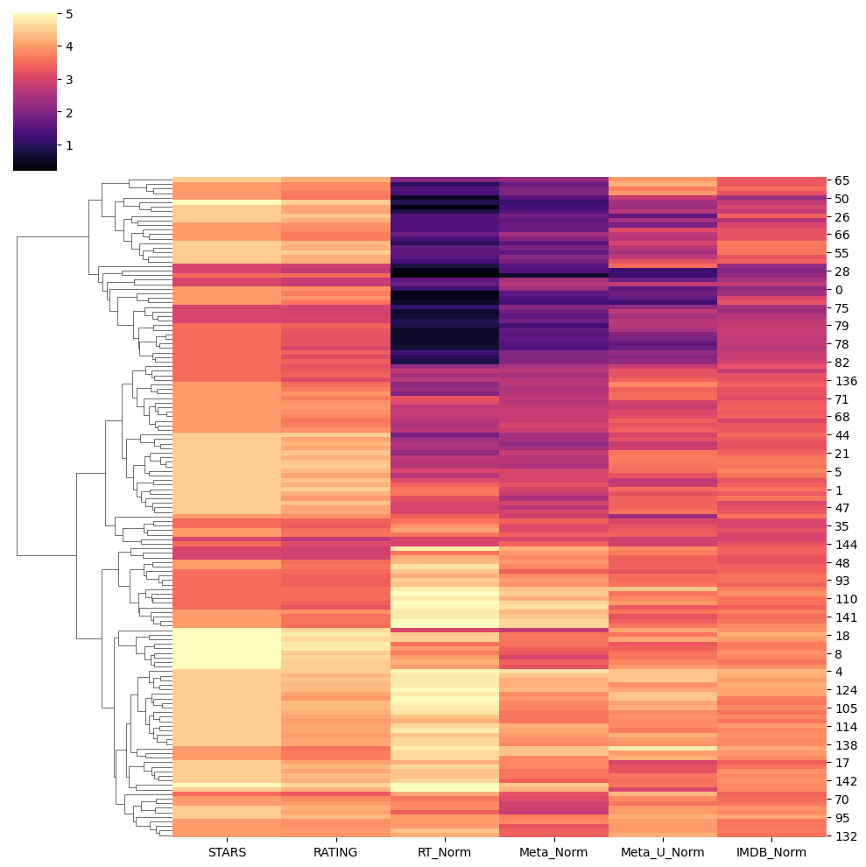
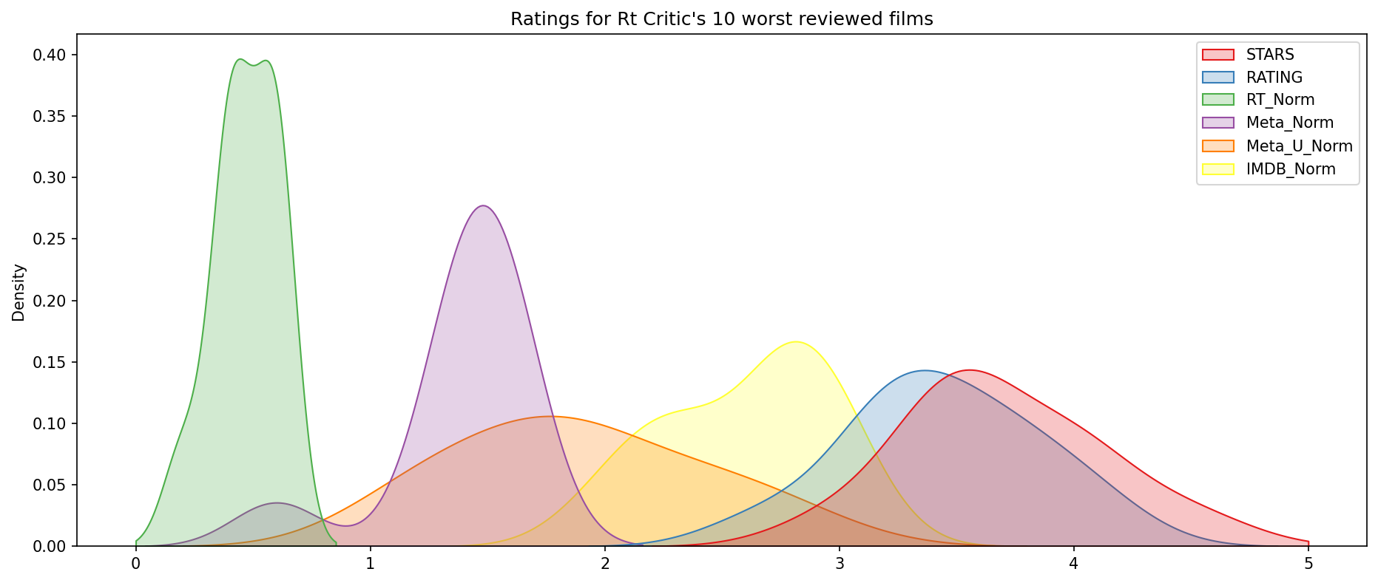
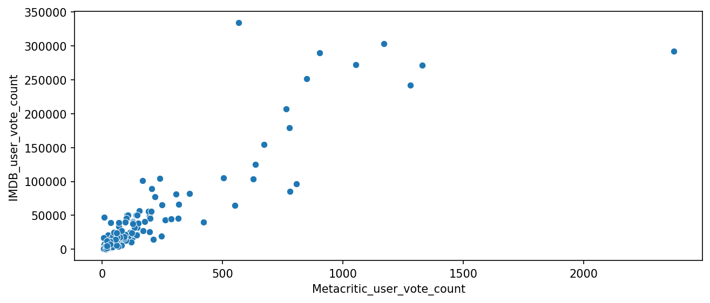
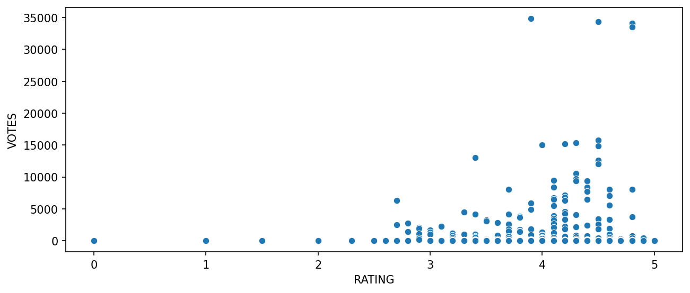
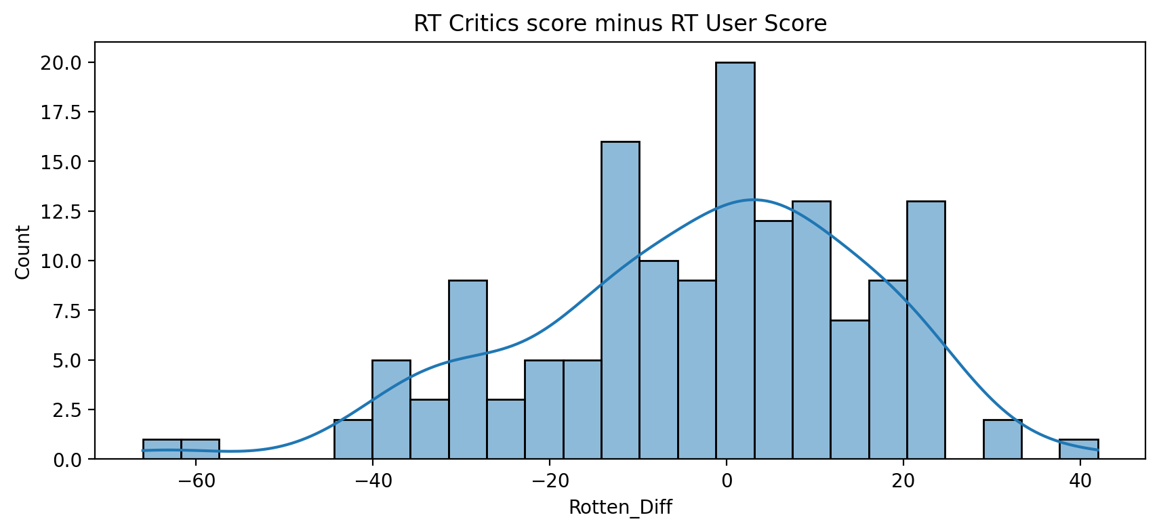
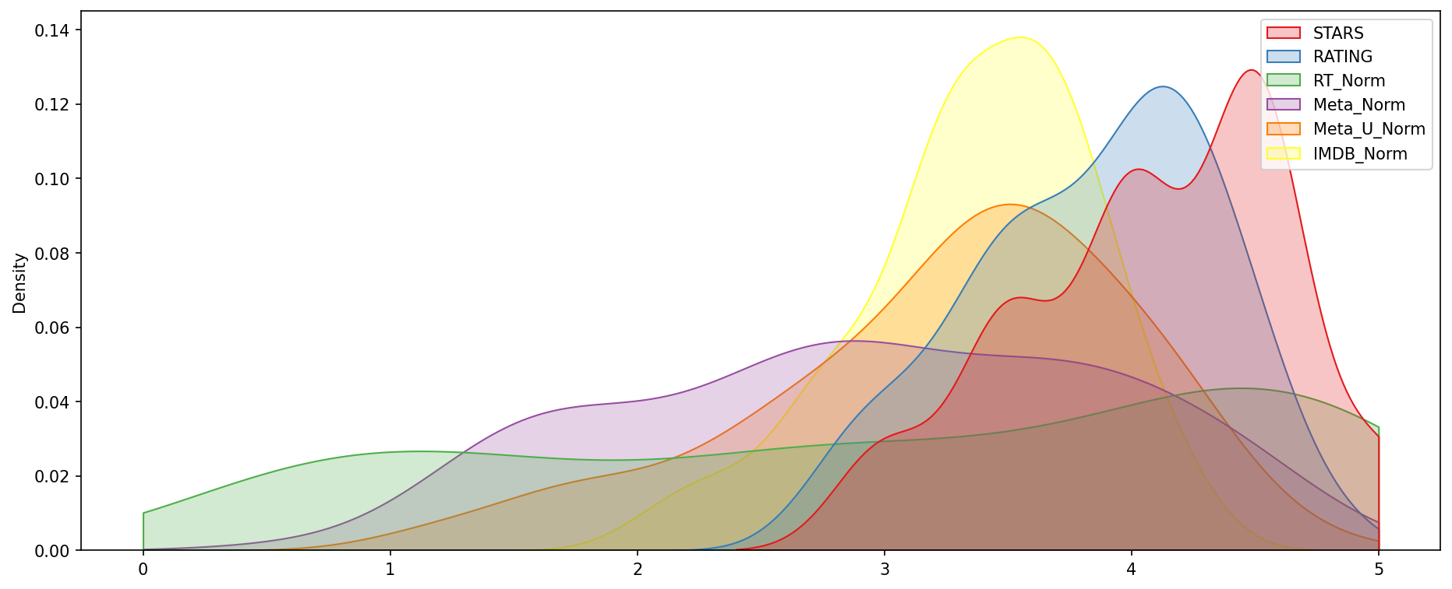
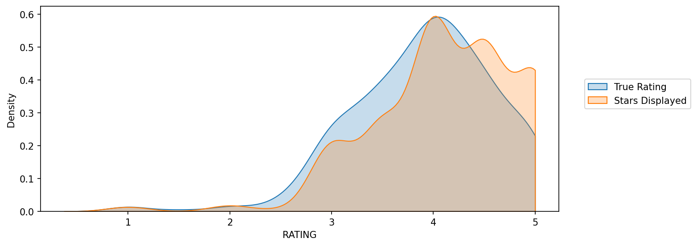
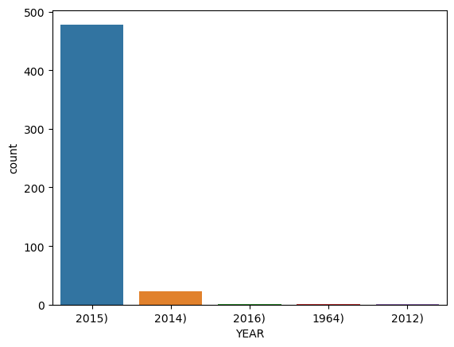
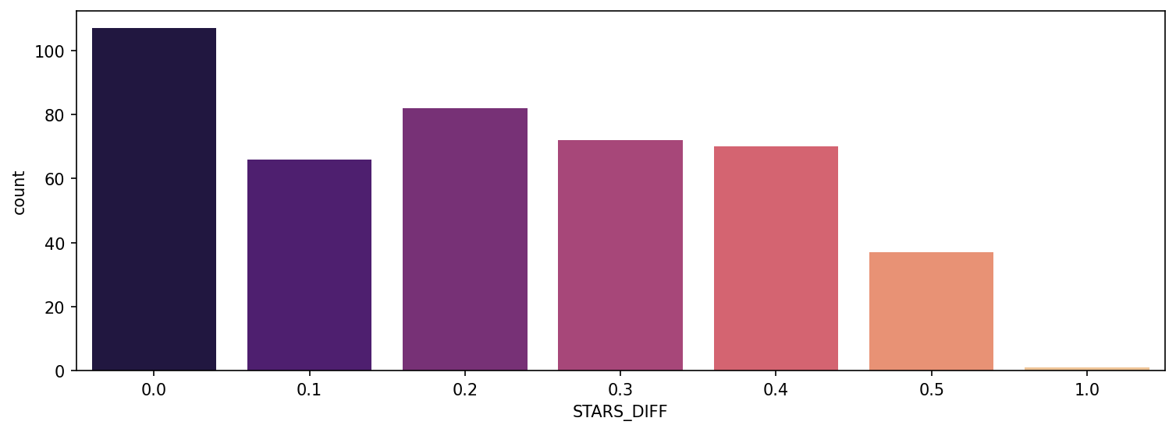
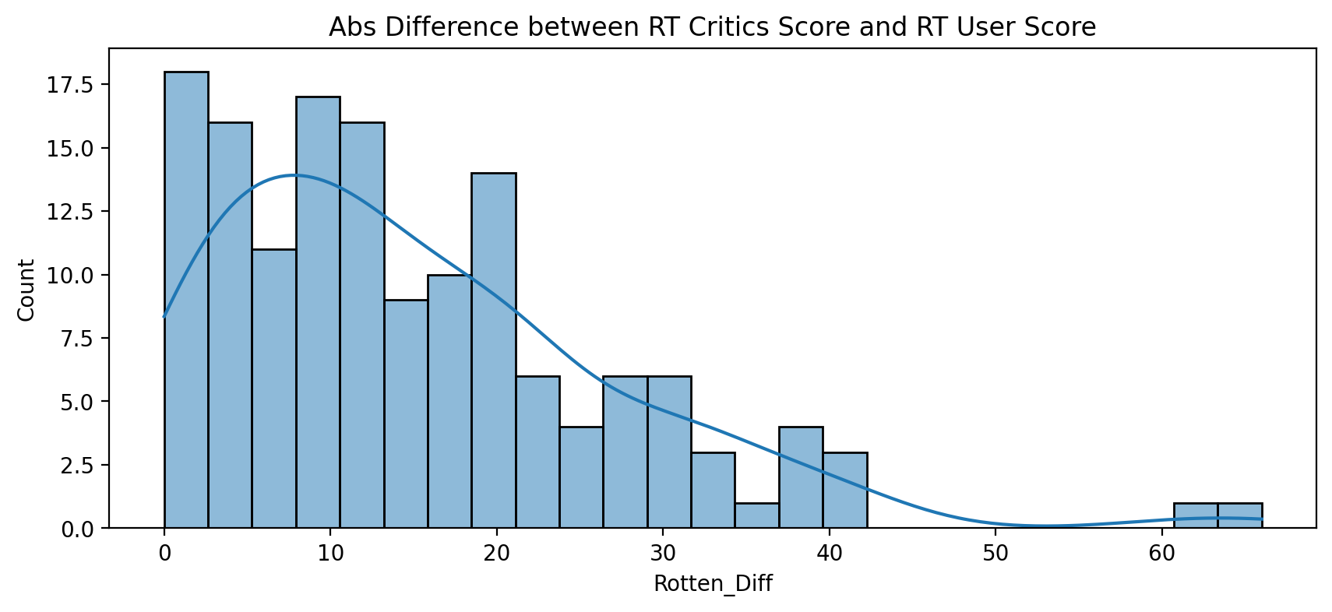
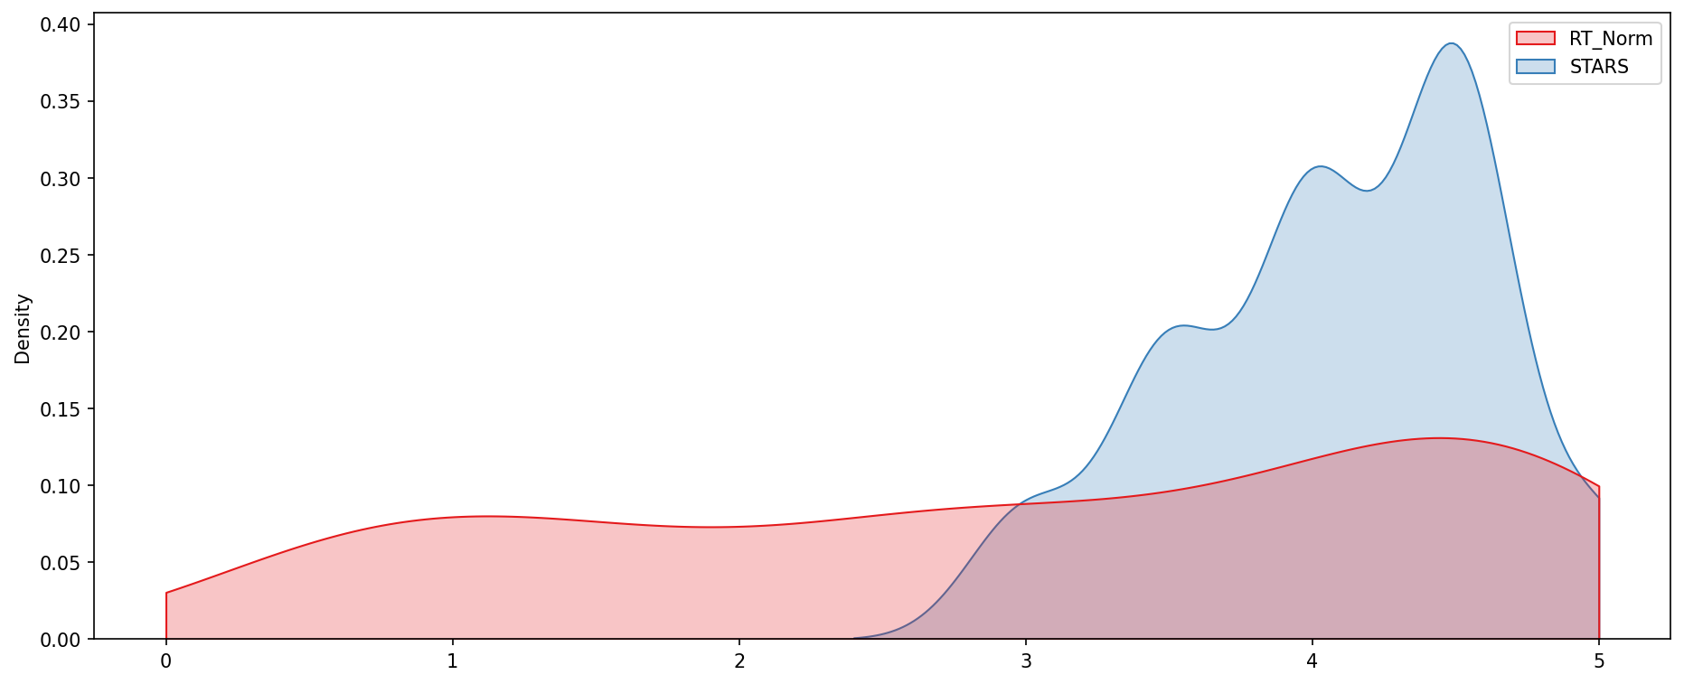
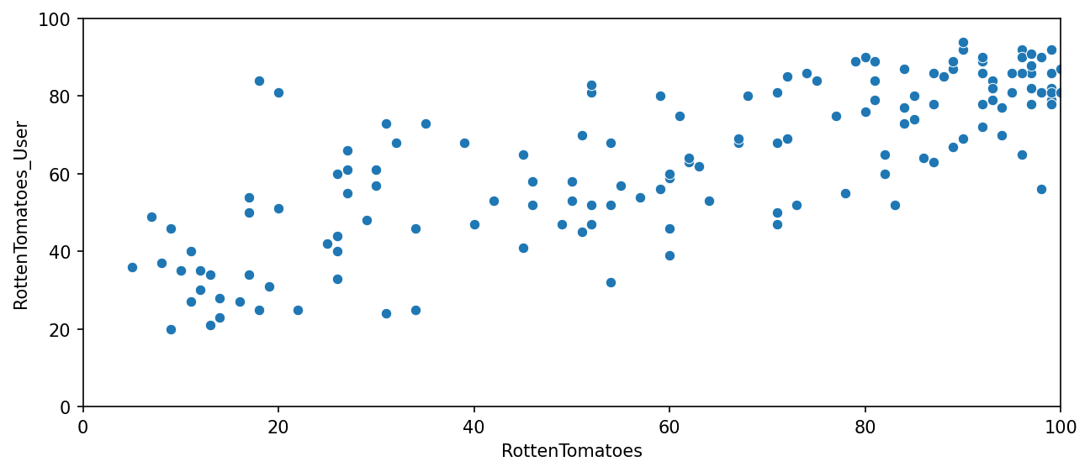
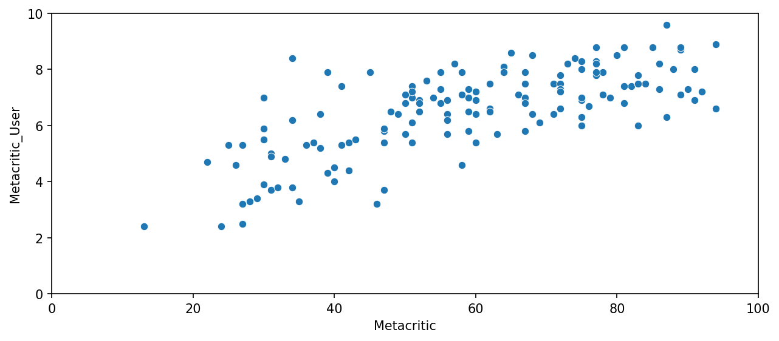
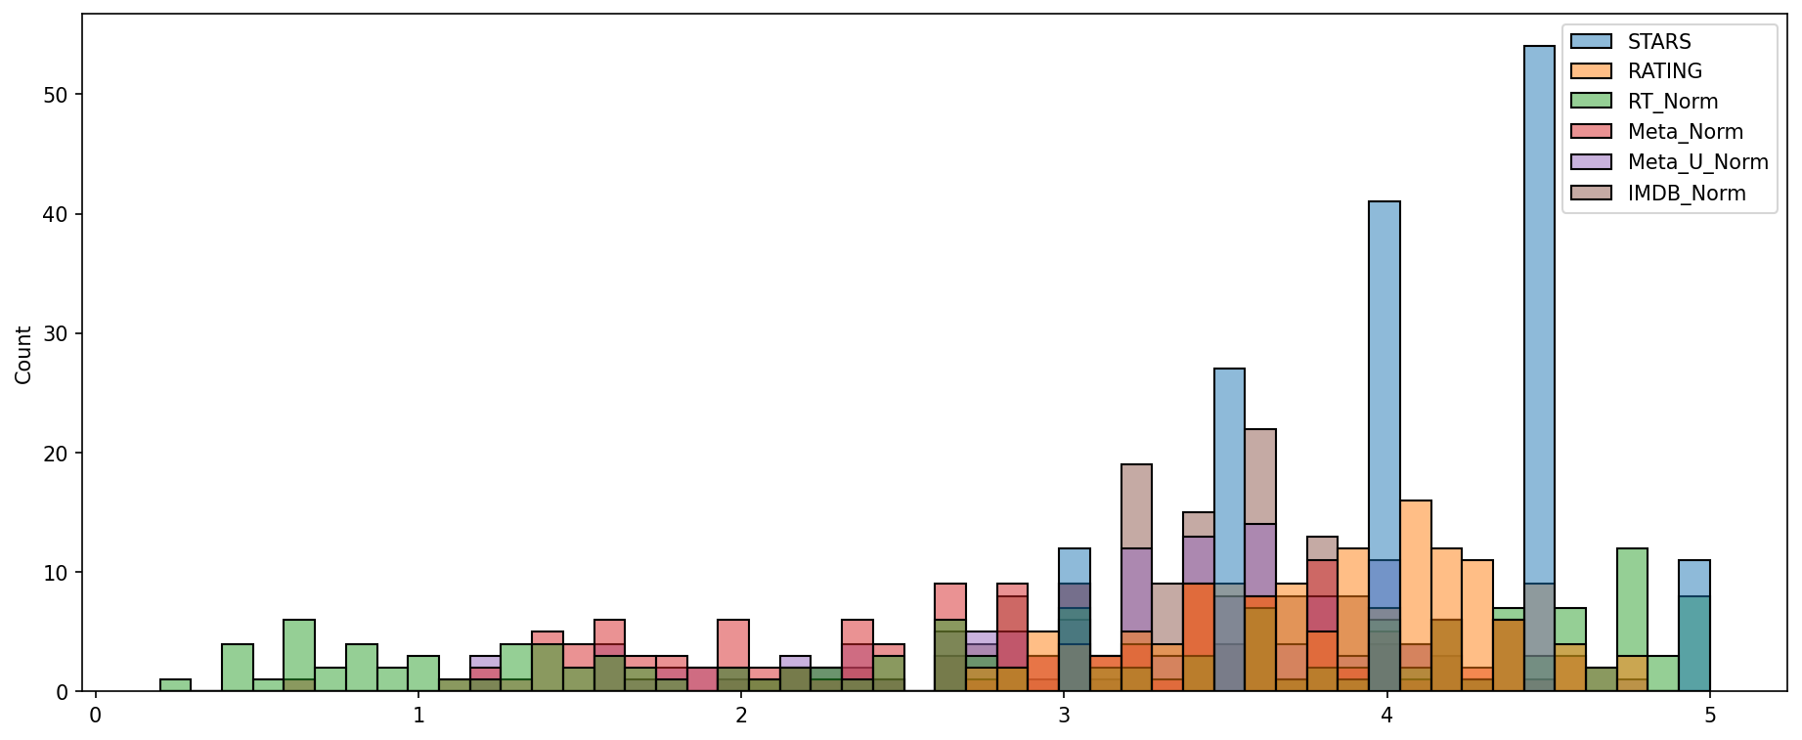
Result

Slide 8
Conclusion
In conclusion, the developed sentiment classification model for movie reviews has proven to be effective in analyzing the sentiment of textual data. By leveraging a convolutional neural network (CNN) architecture and comprehensive data preprocessing techniques, we successfully trained a model capable of accurately predicting whether movie reviews convey positive or negative sentiments.
The evaluation results showcase the model's robust performance, as evidenced by its high accuracy, precision, recall, and F1-score on the test dataset. Furthermore, the model's deployment into a user-friendly interface enables seamless interaction, empowering users to obtain sentiment predictions for movie reviews effortlessly.
Moving forward, continuous monitoring and maintenance of the deployed model will ensure its ongoing reliability and relevance in real-world applications. Regular updates and retraining with new data will further enhance the model's accuracy and adaptability to evolving trends in movie reviews.
Overall, the sentiment classification model represents a valuable tool for decision-making in the realm of movie selection, providing users with actionable insights derived from the sentiment conveyed in reviews.

Slide 9
Future scope
1. Multimodal Sentiment Analysis: Expand the model to incorporate multimodal data, including text, images, and possibly audio, to capture richer representations of sentiment from diverse sources such as movie posters, trailers, and user-generated content.
2. Fine-Grained Sentiment Analysis: Enhance the model to perform fine-grained sentiment analysis, distinguishing between different aspects or facets of sentiment within movie reviews, such as plot, acting, cinematography, and soundtrack.
3. Transfer Learning and Pretrained Models: Explore transfer learning techniques using pretrained models such as BERT, GPT, or RoBERTa to leverage large-scale language representations and further improve the model's performance on movie review sentiment analysis tasks.
4. Domain Adaptation: Investigate domain adaptation methods to adapt the sentiment classification model to specific genres, languages, or cultural contexts within the movie review domain, ensuring robustness and accuracy across diverse datasets.
5. Temporal Analysis: Incorporate temporal analysis techniques to capture temporal dynamics and trends in movie sentiment over time, enabling the model to adapt to changing audience preferences and industry developments.
6. User Personalization: Integrate user feedback mechanisms and personalization features into the model to tailor sentiment predictions based on individual user preferences, viewing history, and demographic characteristics.
7. Sentiment Visualization: Develop visualization techniques to interpret and visualize the sentiment analysis results, providing users with intuitive insights into the overall sentiment trends and patterns within movie reviews.
8. Industry Applications: Explore applications of the sentiment classification model beyond movie reviews, such as analyzing sentiment in social media discussions, product reviews, market sentiment analysis, and customer feedback analysis in various industries.

Slide 10
References
https://seaborn.pydata.org/
https://matplotlib.org/stable/contents.html
https://www.kaggle.com/datasets
https://chat.openai.com/
Team IBM

Slide 11
THANK YOU

